Slide 1


Don Bosco Institute of Technology Department of Electronics and Communication Engineering
INTERNSHIP ON
SENSE AMPLIFIER FOR SRAM CELL USING CADENCE
Presented by:
Harsha N - 1DB20EC031
Guided By
Prof. Tejaswini M L
Assistant Professor
Dept. of ECE, DBIT

Slide 2
CONTENTS
ABSTRACT
INTRODUCTION
LITERATURE SURVEY
OBJECTIVE
PROBLEM STATEMENT
METHODOLOGY
SCHEMATIC
WAVEFORM
ADVANTAGE & APPLICATION
TOOS USED
REFERENCES

Slide 3
ABSTRACT
Sense amplifier for Static Random Access Memory (SRAM) cells using Cadence Virtuoso. The sense amplifier plays a crucial role in the read operation of SRAM, enhancing the stability and reliability of data retrieval. The design process involved leveraging the capabilities of Cadence Virtuoso, a widely-used Electronic Design Automation (EDA) tool, to implement and simulate the sense amplifier circuit.
Simulation results demonstrated the functionality and effectiveness of the designed sense amplifier in amplifying small voltage differentials during the read operation, thereby enabling reliable data retrieval from the SRAM cell.

Slide 4
INTRODUCTION
This introduction focuses on the emergence of a low-power, high-performance sense amplifier that incorporates CMOS (Complimentry Metal-Oxide-Semiconductor) biasing techniques.
The CMOS-biased approach promises to mitigate this power overhead, making it an attractive solution for Memory reading applications.
Memory systems, especially SRAM and DRAM, are expected to deliver high-speed read and write operations.
This demand for speed is relentless, as it underpins the performance of various computing tasks.

Slide 5
LITERATURE SURVEY
Sl.No | Ist Author, Title, Publication Year | Limitation
1. | Design of Low Power PMOS Biased Sense Amplifier Using Lector Approach. | More transistors are used and more delay.
2. | PMOS Biased Sense Amplifier Using Cadence Virtuoso With gpdk 90nm Technology | Both 180nm and 90nm transistos is used .

Slide 6
LITERATURE SURVEY
Sl.No | Ist Author, Title, Publication Year | Limitation
3. | 2021 IEEE Proceedings of the 12th international synopsis on advanced topics in electrical engineering. | Delay is not reduced as much.
4. | Low power single bit line 6T SRAM cell with high read stability. | Designed for only 1 bitcell.
5. | Efficient current mode sense amplifier for low power SRAM. | It uses clamped bitline technique.

Slide 7
OBJECTIVE
Power Efficiency: One of the primary objectives is to reduce power consumption in memory systems. This includes minimizing both active power during sensing and standby power when the sense amplifier is not in use.
High Speed: Ensuring reliable and accurate sensing of small signal differentials in memory cells is paramount. The sense amplifier should be designed to maximize the speed, contributing to high data integrity and system reliability.
Low Leakage Current: CMOS biasing is employed to reduce leakage current in the sense amplifier, particularly during standby periods. Minimizing leakage current is a crucial objective to lower overall power consumption, especially when the sense amplifier is idle

Slide 8
PROBLEM STATEMENT
Scalability and Adaptability: The sense amplifier design must be scalable to accommodate the ever-growing demands for memory density and performance. It should also be adaptable to emerging memory technologies and scaling requirements.
Integration Complexity: Integrating sense amplifiers into existing memory architectures can be a complex and time-consuming task. The design should facilitate ease of integration while maintaining compatibility with current memory system designs.

Slide 9
METHODOLOGY
Sense amplifier:- It is an device which read voltage or current signal from memory and give the output in bitwise(0/1) with lower delay.
Types of sense amplifier:-
a) Voltage Sense Amplifier (VSA)
b) Current Sense Amplifier (CSA)
c) Charge Transfer Sense Amplifier (CTSA)
In this project we are working on the Voltage sense amplifier.
1) Low impedance in output.
2) Less noise.
3) Less area.

Slide 10
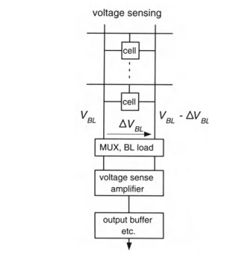
BLOCK DIAGRAM

Slide 11
BLOCK DIAGRAM EXPLANATION
The block diagram consists of array , BL load, Voltage sense amplifier And output buffer.
The array is the memorial which consist of multiple bit cells in columns it is connected to mux as well as BL load Then both the mux and bl load is connected with Voltage and amplifier then output buffer.
The bit cells stores the data and mux decides the read and write operation and bl load is used to precharge the bitlines.
The voltage and sampler take the voltage difference which was created by the bit cell Resolute into 1 or 0 Based on the memory storage data the voltage sense amp resolute.
The output buffer is used to get the resolute data in both side.

Slide 12
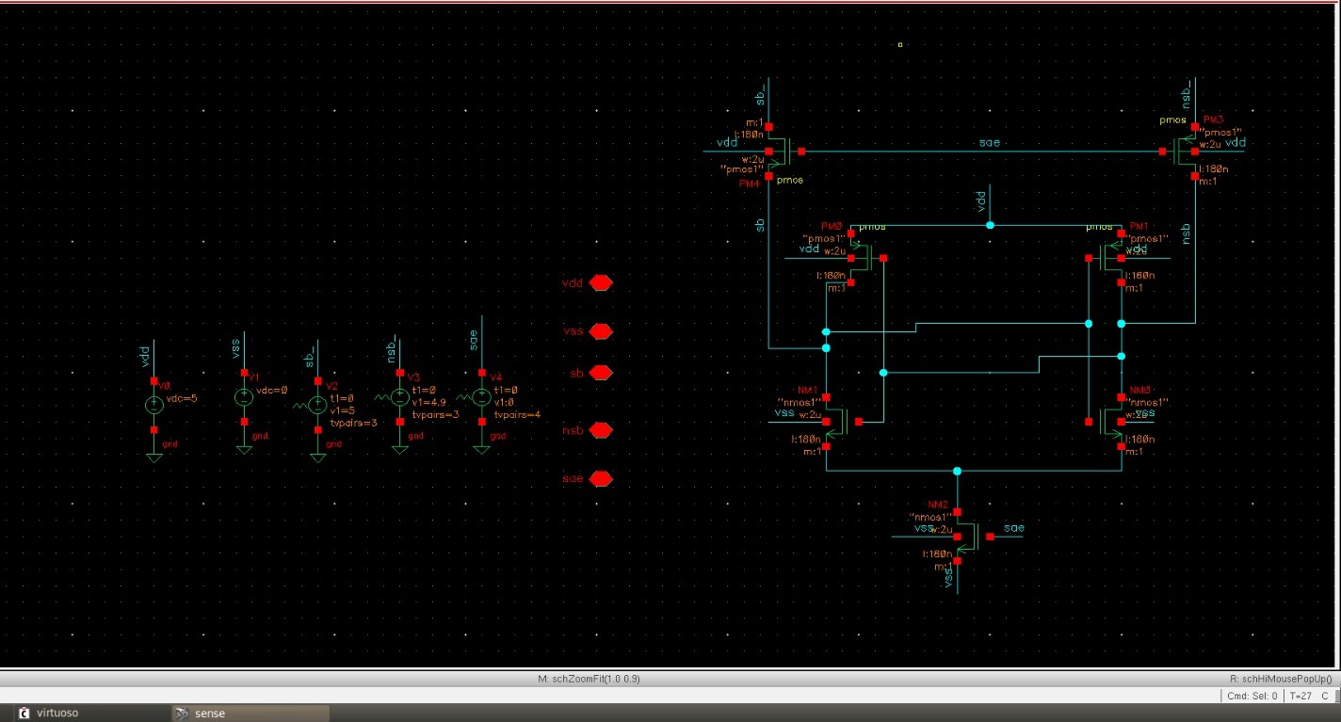
SCHEMATIC OF SENSE AMPLIFIER

Slide 13
EXPLANATION OF SENSE AMPLIFIER
The voltage sense amp works on voltage difference created by bit cell in Bitline and Bitline Bar.
The difference created by wordline and Rsel(Bifurcation Pmos) Is used by voltage sense amp at the nodes sd and nsd.
By this difference between the voltage either one Nmos of voltage sense amp Became weaker due to that it discharge slow and another discharges faster.
After complete discharge of node wich having less voltage will goes to 0 and another became 1.

Slide 14
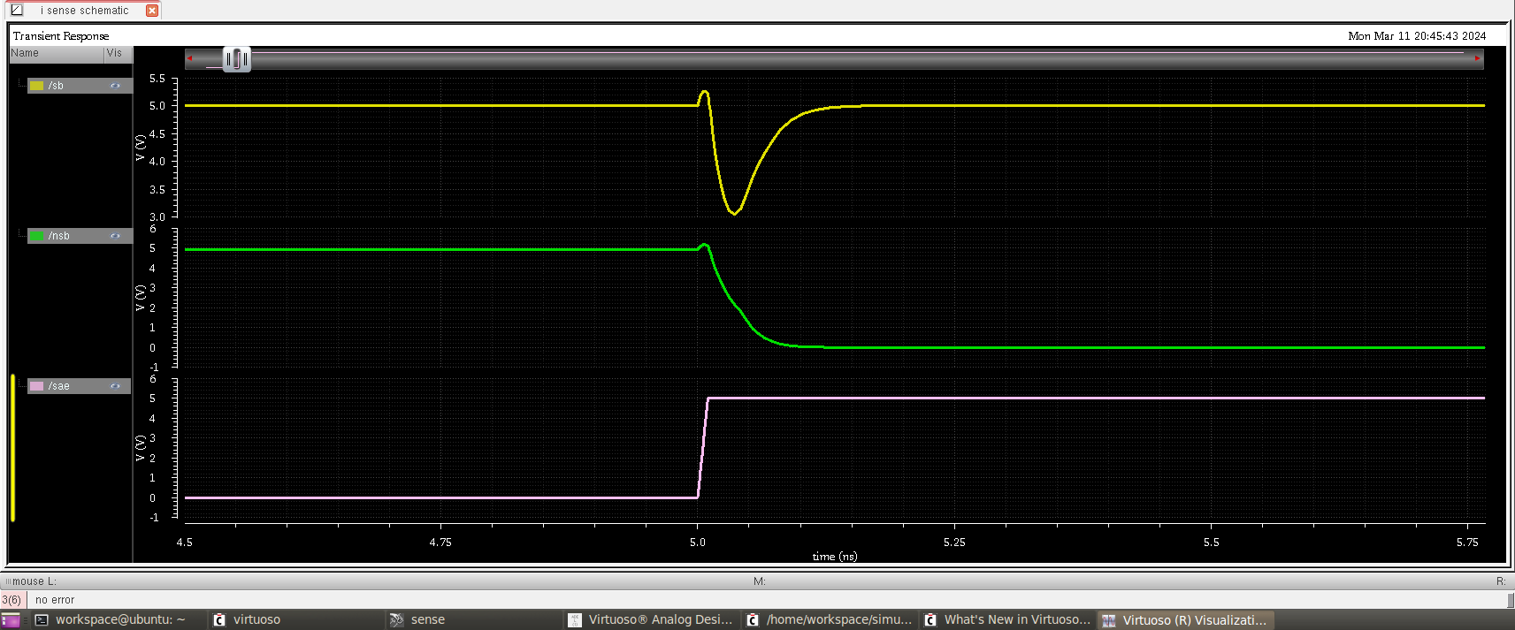
WAVEFORM

Slide 15
ADVANTAGES
Reduced Power Consumption.
Low Impedance.
Less Read delay.
Low Voltage.
Less area.
Working at both low and high temperature.
Independent on voltage.

Slide 16
APPLICATION
Static Random-Access Memory (SRAM).
Embedded Memory in Microcontrollers and Microprocessors.
Mobile Devices.
Automotive Electronics.
High-Performance Computer.
Dynamic Random-Access Memory (DRAM).

Slide 17
TOOLS USED
Processor :2.5 gigahertz(GHz)
RAM: A minimum of 4GB of RAM
Hard disk: A minimum of 20 GB of available space
Software tool used: Cadence Virtuoso

Slide 18
CONCLUSION
Performance Evaluation: Summarize the key performance metrics of the sense amplifier, such as speed, power consumption, and area. Highlight any trade-offs made during the design process.
Functionality and Stability: Discuss the functionality of the sense amplifier under different operating conditions and how well it maintains stability during read and write operations.

Slide 19
REFERENCES
Design of High Speed Sense Amplifier for SRAMRakesh Oayaramji Chandankhede, Oebiprasad Priyabrata Acharya, Pradip Kumar Patra,20epartment of Electronics and Communication Engineering, National Institute of Technology, Rourkela, Odisha, India
2021 IEEE Proceedings of the 12th INTERNATIONAL SYMPOSIUM ON ADVANCED TOPICS IN ELECTRICAL ENGINEERING.
Design of Low Power PMOS Biased Sense Amplifier Using Lector Approach 10.1109/ICSE56004,2022.9863214.
PMOS Biased Sense Amplifier Using Cadence Virtuoso With gpdk 90nm Technology 10.1109/NKCon56289.2022.10127061.
V. Pi-Ho Hu, "Reliability-Tolerant Design for Ultra-Thin-Body GeOI 6T SRAM Cell and Sense Amplifier", IEEE Journal of the Electron Devices Society., Vol. 5, No. 2, pp. 107 - 111, 2017.

Slide 20
THANK YOU

